Slide 1


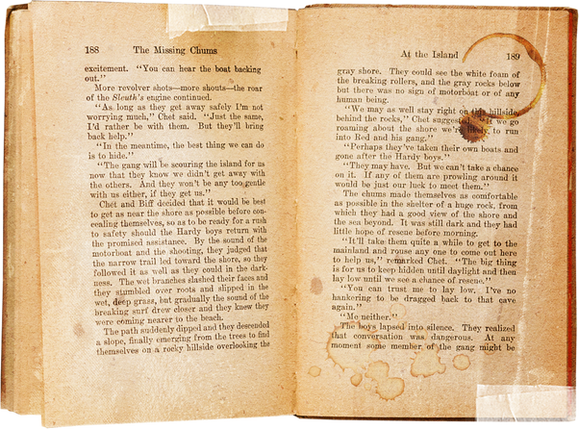
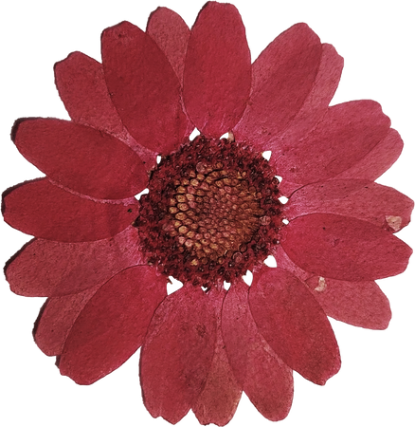
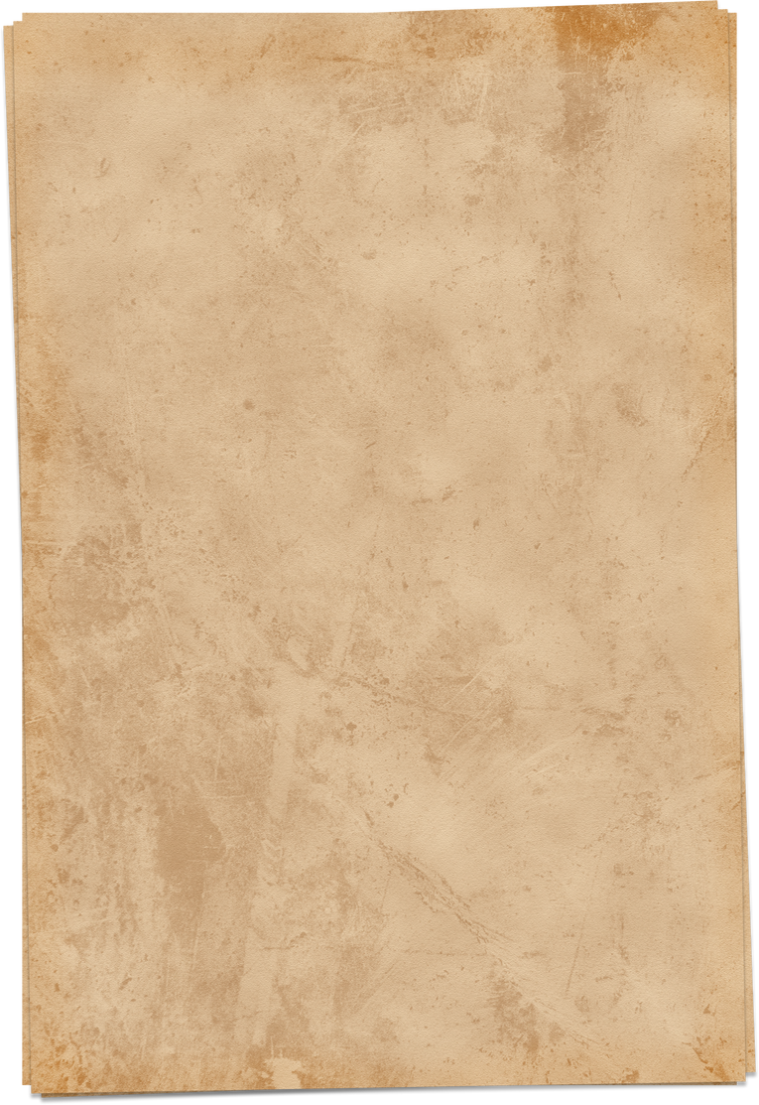


COVER
LETTER
Presented by Afreen Nasrullah, Uswa Asad and Naveed

Slide 2
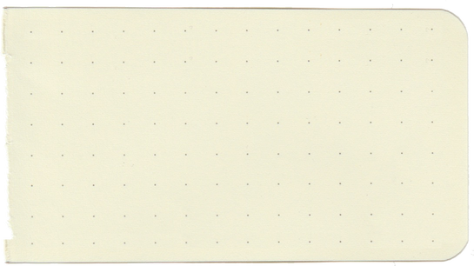
CONTENTS
WHAT IS A COVER LETTER?
WHY IS A COVER LETTER IMPORTANT?
HOW TO WRITE A COVER LETTER?
COVER LETTER VS. MOTIVATION LETTER

Slide 3


WHAT IS A COVER LETTER?
A cover letter is a brief document (200-250 words) that is sent along with your CV/resume when applying for a job. It serves as your first introduction to the employer and provides a chance to showcase why you are a strong candidate for the role. A well-crafted cover letter highlights your relevant skills, experience, and enthusiasm for the position. It also helps recruiters understand how you can contribute to their company’s success before they review your resume.

Slide 4
WHY IS A COVER LETTER IMPORTANT?
A well-written cover letter increases your chances of getting hired by making your application stand out.
Why do employers ask for a cover letter?
It introduces you professionally before they look at your CV.
It highlights skills that match the job requirements.
It shows your interest in the company and the role.
It demonstrates your communication skills and ability to present yourself effectively.
Think Like an Employer:
If two candidates have similar CVs, the one with a stronger cover letter is more likely to get an interview.

Slide 5
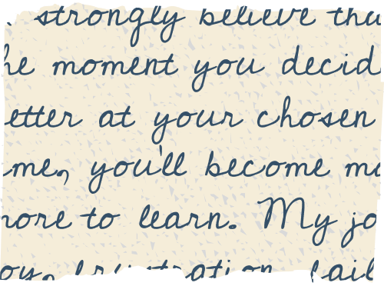


HOW TO WRITE A COVER LETTER?
Sender’s Details –
Your name, contact info (top right/center).
Receiver’s Details –
Hiring manager’s name, company, and address.
Salutation –
Address the recruiter properly (e.g., Dear Mr. Smith).

Slide 6
HOW TO WRITE A COVER LETTER?
Paragraph 1: Introduction
State the job title and company name.
Mention where you found the job listing.
Express enthusiasm for the role.
Paragraph 2: Skills & Experience
Highlight your relevant skills and achievements.
Provide examples of how you meet the job’s requirements.
Paragraph 3: What You Bring to the Company
Showcase your personality, strengths, and motivation.
Explain how you can contribute to the company’s goals.
Paragraph 4: Closing Statement
Express interest in an interview.
Mention your availability and thank the recruiter.

Slide 7
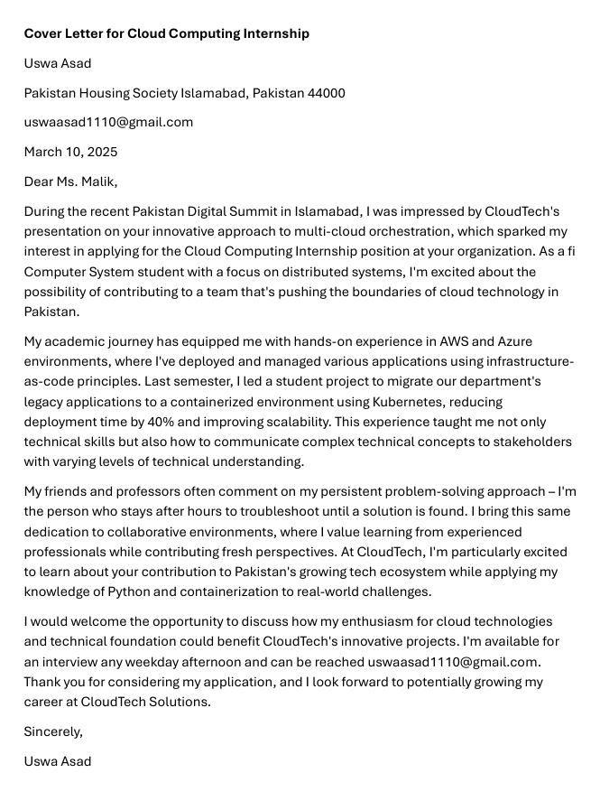
LAYOUT OF COVER LETTER

Slide 8
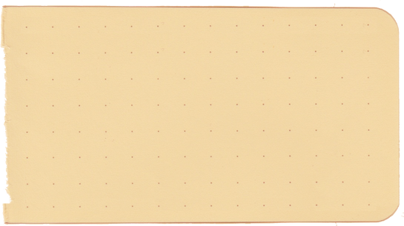
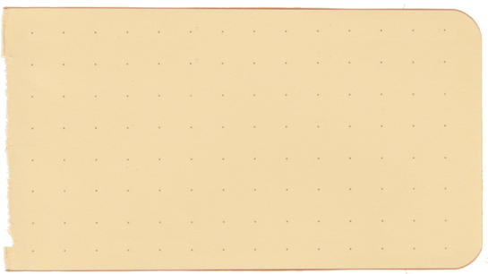
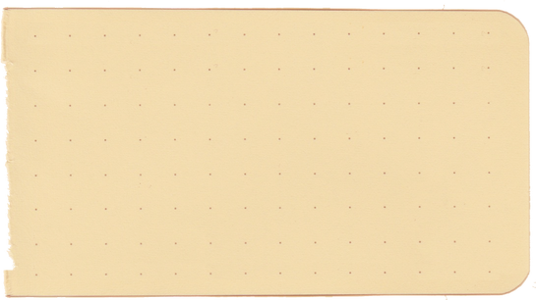
COVER LETTER VS. MOTIVATION LETTER – WHAT’S THE DIFFERENCE?
FEATURE | COVER LETTER | MOTIVATIONAL LETTER
Purpose | Job application | Academic programs, internships, scholarships
Focus | Skills, experience, and fit for a specific job | Personal motivation and goals
Length | Short (200-250 words) | Can be longer (up to 1 page)
Tone | Professional and job-oriented | Personal and passion-driven
Example Usage | Applying for a software developer job | Applying for a master's degree in computer science

Slide 9
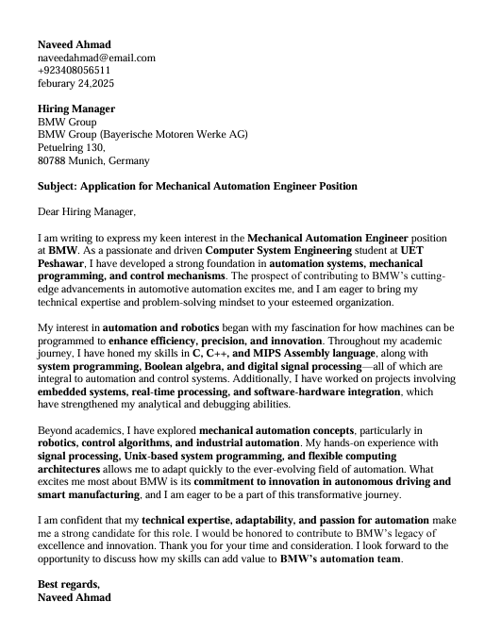
COVER LETTER VS. MOTIVATION LETTER – WHAT’S THE DIFFERENCE?

Slide 10
THANK
YOU

